Slide 1
Collaboration in Action:
Washington County Shared Services Initiative

Slide 2
Shared Services History
2014 – Medical Examiner Shared Services – Waukesha County
2014 – Aquatic Invasive Species Division – Waukesha County
2016 – Washington Ozaukee Public Health Department
2017 – Shared Employee Health Clinic – West Bend
2019 – Shared Transit Manager – Ozaukee County
2020-2021 – Partnerships in Response to COVID
2023 – Shared Services Initiative Begins

Slide 3

Washington Ozaukee Public Health Department
Governance: Joint Board of Health
Cost share: population-based
Staff: Ozaukee County
Fiscal Agent: Ozaukee County
IT Provider: Washington County
Statutory Change to 251.11

Slide 4
Washington Ozaukee Public Health Department
Years of planning and discussion.
Significant change for both organizations.
Annual Tax Levy Savings: $250K x 10 years = $2.5M

Slide 5
Shared Services History
2014 – Medical Examiner Shared Services – Waukesha County
2014 – Aquatic Invasive Species Division – Waukesha County
2016 – Washington Ozaukee Public Health Department
2017 – Shared Employee Health Clinic – West Bend
2019 – Shared Transit Manager – Ozaukee County
2020-2021 – Partnerships in Response to COVID
2023 – Shared Services Initiative Begins
Notes:
-

Slide 6
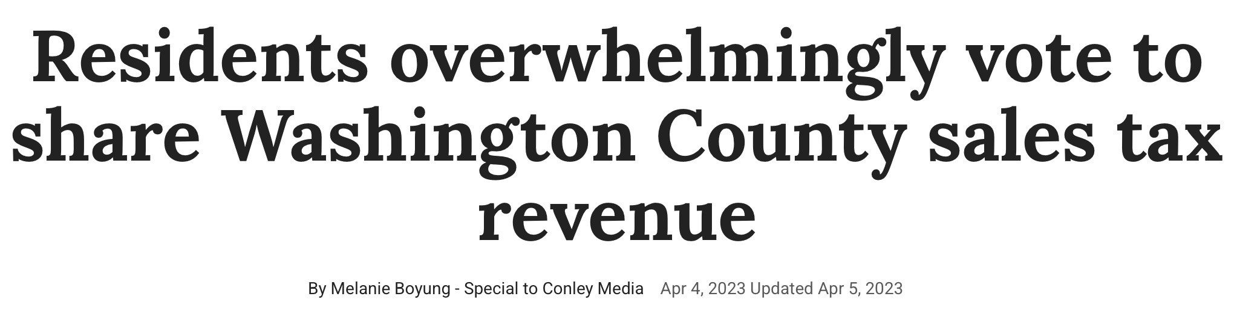
Background
Long history of partnership
County Sales Tax
Municipal requests to share the sales tax

Slide 7

Program Creation
Meetings with Chief Elected Officials
County Executive Shared Services Proposal
2024-2025 Budget
Shared Revenue
Strategic Plan

Slide 8
Washington County Shared Services
Shared Services:
Roadway Maintenance
Information Technology
Geographic Information Systems
Municipal Planning
Patrol Deputy
Shared Services (ctd):
Consolidated Dispatch
Tax Bills
Elections
Grant Programs:
EMS & Fire Grants
Lead Laterals
Radio Grants

Slide 9
Washington County Shared Services
Initial Parameters:
$1.8M in Grants and direct service provision.
First-come, first-served until capacity is reached.
  Capacity = dollar max or new hire time constraints.
Contracts for new services.
Local elected body takes action to accept.
Dashboard

Slide 10
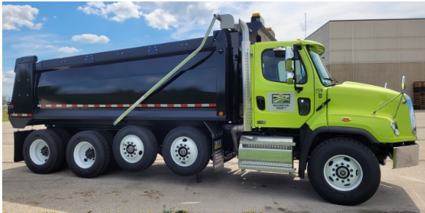
Roadway Maintenance
County provides pavement and roadway maintenance.
  Municipality charged for materials only.
  County funds labor and equipment (includes equipment rental).
Current value to municipalities: $320K.
All municipalities participate.
Distributed via formula.
Examples:
  Mastic work.
  Chip sealing.
  Mechanical repairs to snowplow fleet.

Slide 11
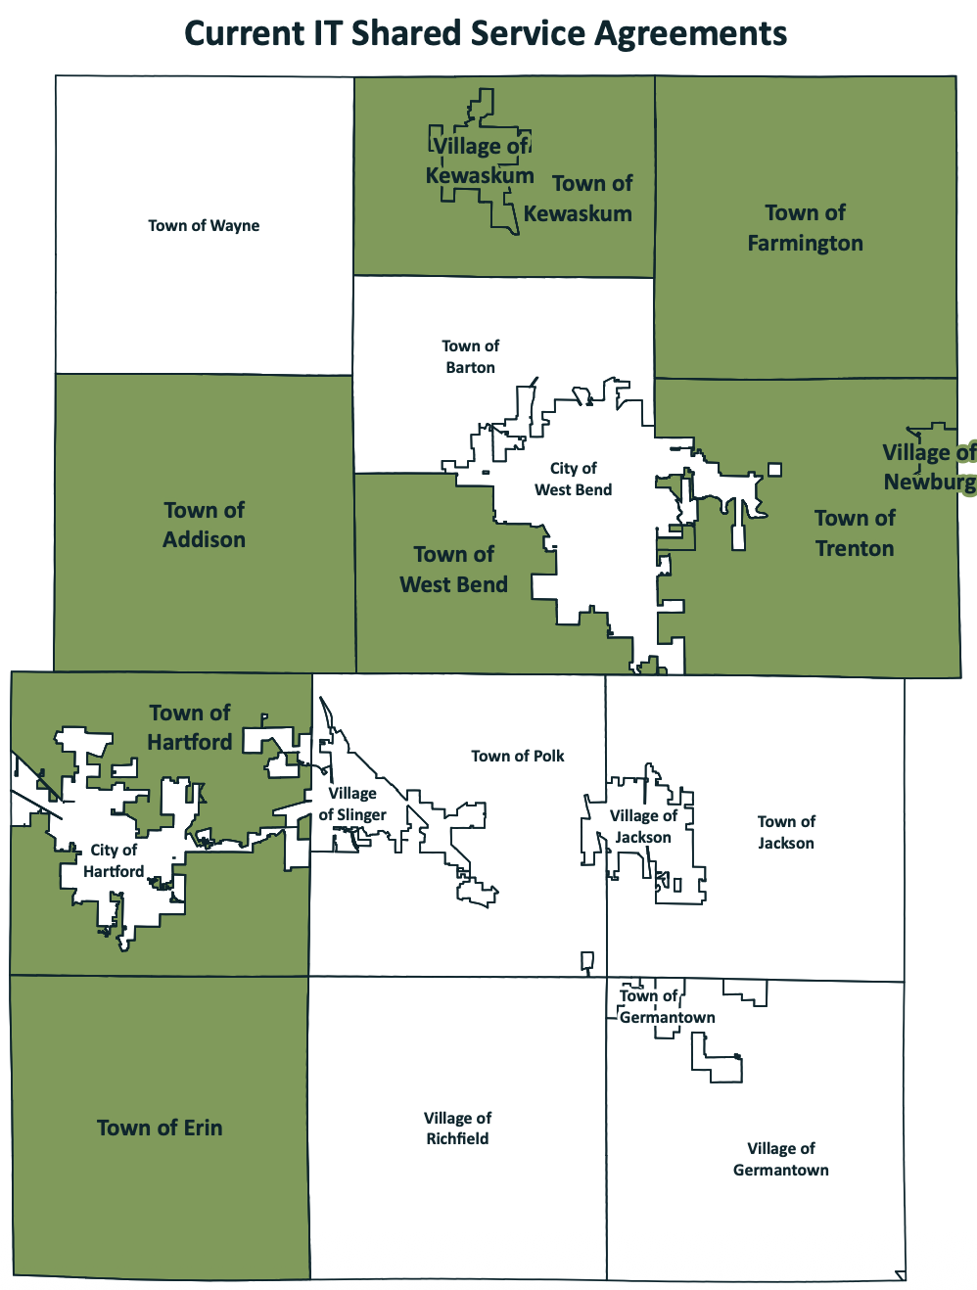
Information Technology
County provides IT services.
  Charged for software and hardware only.
  County funds labor.
Currently serving 9 municipalities.
Current value to municipalities: >$150K.
Examples include:
  Security, network, firewall, user management, IT planning

Slide 12

Geographic Information Systems (GIS)
County provides GIS services.
  Charged for licensing and equipment only.
  County funds labor.
Currently serving 11 municipalities.
Current value to municipalities: >$100K.
Examples include:
  Digitizing and updating land use maps.
  App development

Slide 13
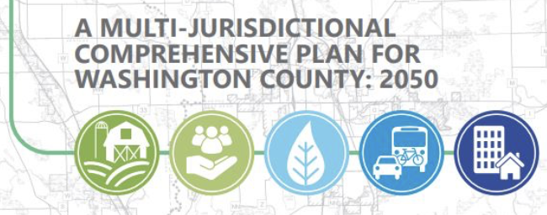
Municipal Planning
County provides advanced municipal planning services.
  Research, develop, update, and implement current and long range plans and amendments.
  Currently serving 4 municipalities.
  Currently value to municipalities: >$50K.
  Examples:
    Comprehensive Plan Update
    Sewer Service Area Plan Update

Slide 14

Patrol Deputy
County shares cost of a shared patrol deputy with Town.
  Municipality requested additional law enforcement presence.
  County values this additional patrol.
  County charges Town for 50% of costs for:
    Labor
    Vehicle
    Equipment
  Currently value to municipality: >$75K.

Slide 15
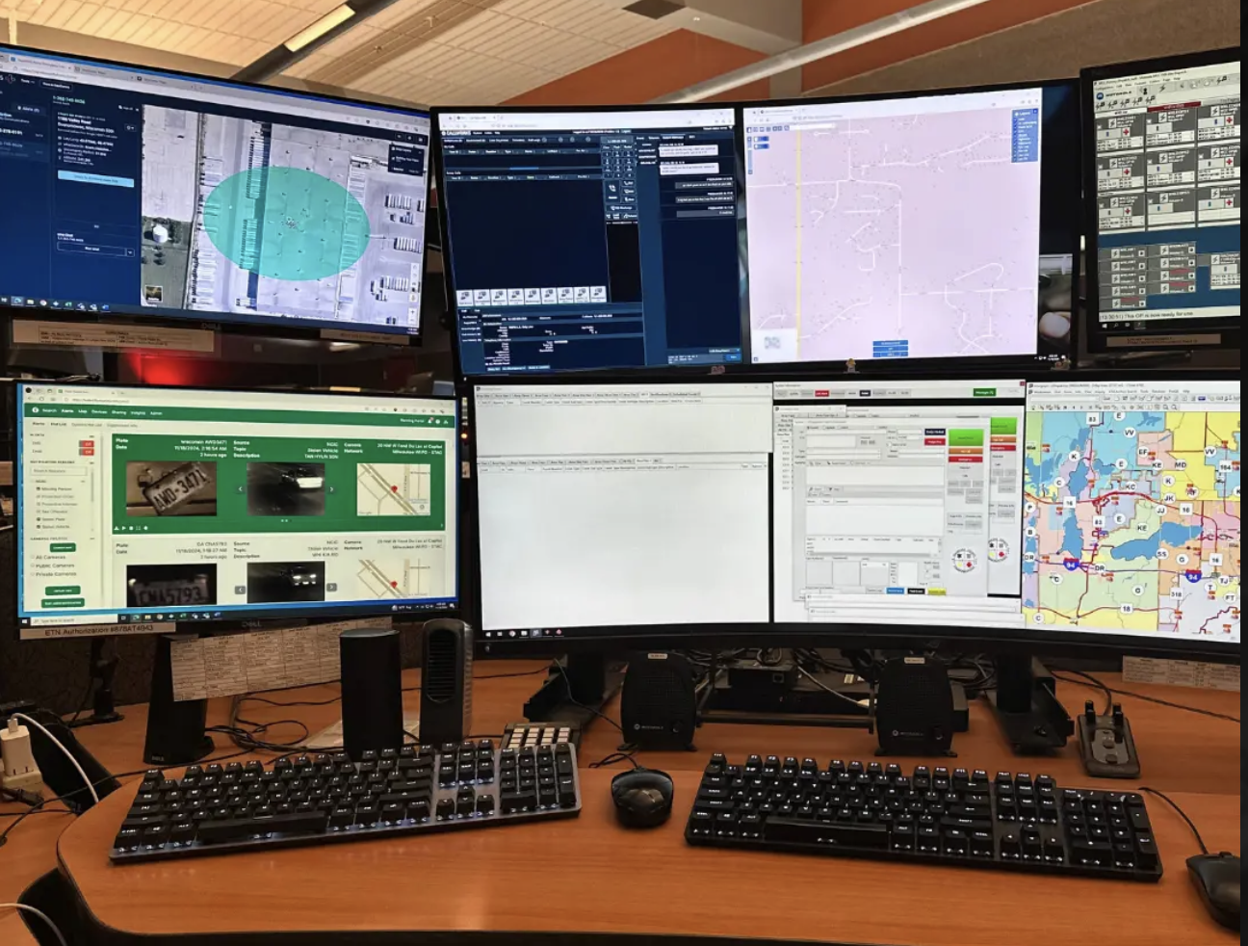
Consolidated Dispatch
New partnerships with 2 of the County’s largest municipalities.
  No cost to community.
  Hartford in 2024
  Germantown in 2025
Continue the longstanding partnerships with remaining communities.

Slide 16

Tax Bills
County prints and mails tax bills for all communities.
  Historically done as a fee-for-service.
  Now doing service free of charge.
  Estimated value: $90K.

Slide 17

Elections
County performs work related to elections.
  Historically done as a fee-for-service.
  Now doing service free of charge.
  Estimated value: >$50K.
  Value to municipalities and other taxing jurisdictions.
Add: Extended Hours for In-Person Absentee

Slide 18
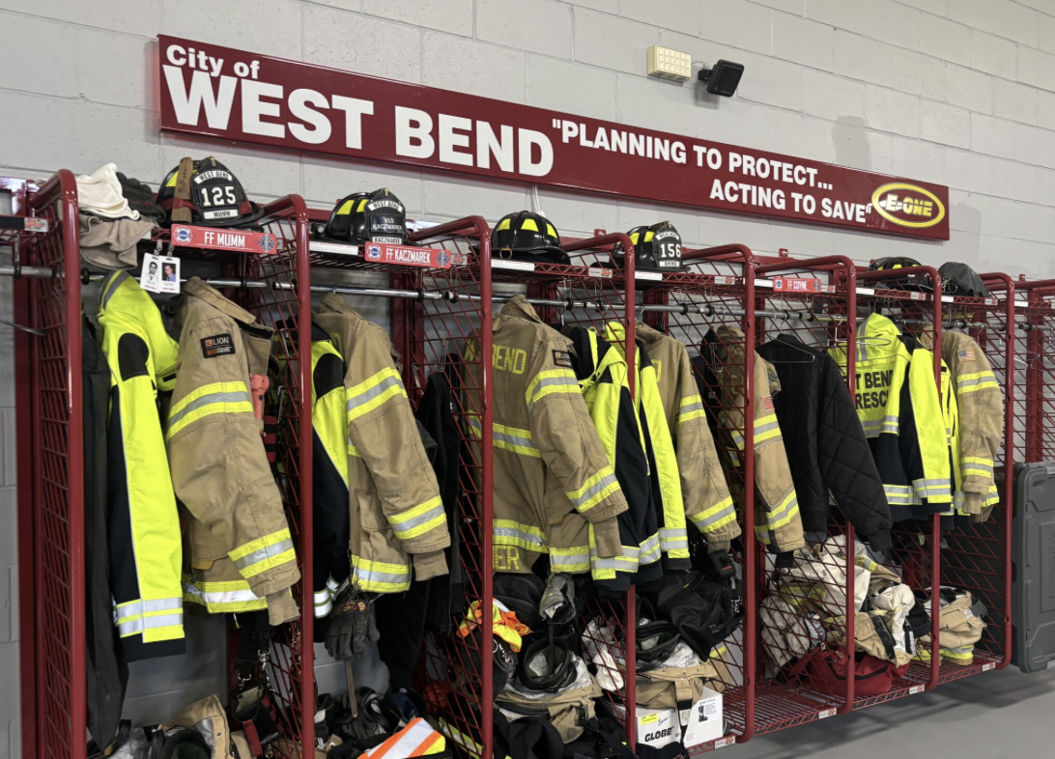
EMS & Fire Grants
Direct financial assistance to municipalities to support Fire/EMS efforts at the local level.
  $1 million annually since 2024.
  Formulaic distribution.
  Direct cost offset for municipalities.
  Working on a permanent solution.
    County-funded study.

Slide 19
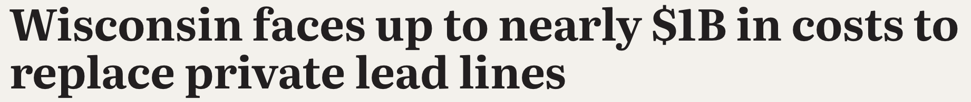
Lead Lateral Grants
Funds have been committed for the removal of lead laterals located in the County.
  $3.1M committed to the program for 2024-2026.
  4 municipalities served (2 now lead-free).
  More than 80 lead laterals have been replaced to-date.

Slide 20
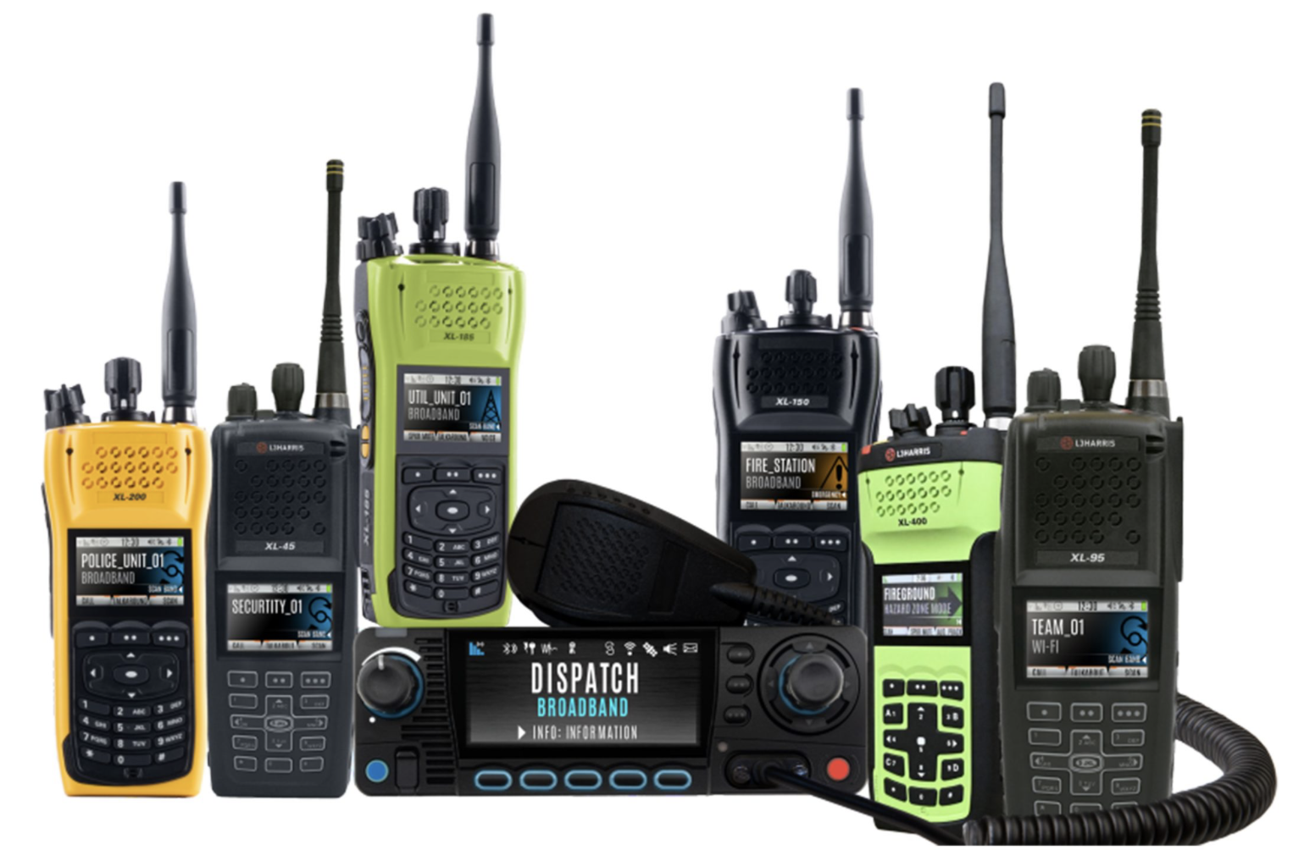
Radio Grants
Grant program to fund new municipal public safety radios.
  Designed to mitigate municipal costs for adding public safety personnel.
  >50 radios deployed to-date.
  $6K to $9K each.

Slide 21
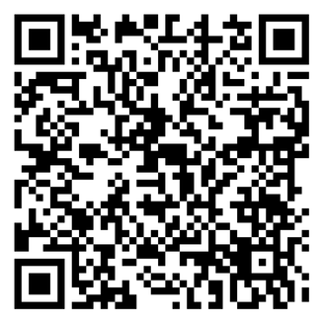
Shared Services
Dashboard
  County Executive Web Page
  Dashboard Link:

Slide 22
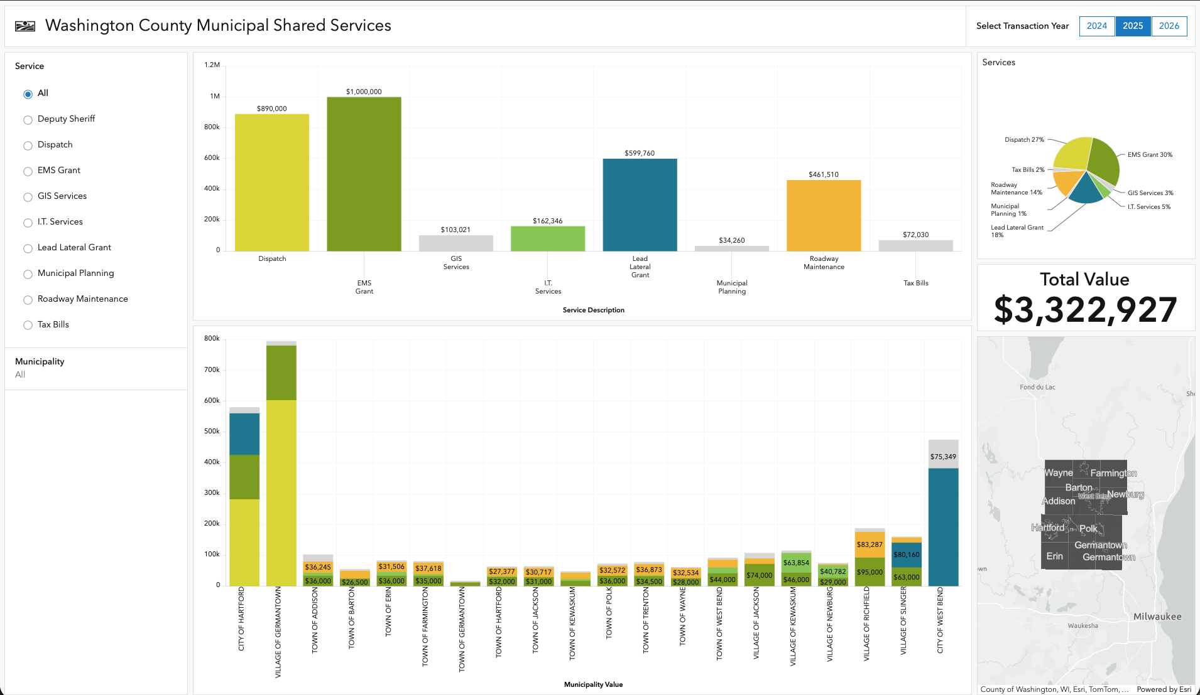

Slide 23
Innovation Grant
Washington County: 4 applications pending.
Opportunity: Utilize for additional innovation.
Challenges:
  Contract structure
  Timing
  Prior year cost

Slide 24
Next Steps
Continue seeking opportunities to enhance.
Chief Elected Official meetings continue.
Communicate other county-funded service provision.
Other Big Issues on the Horizon:
  Emergency Medical Services (EMS) & Fire
  County IT Consortium

Slide 25
Observations & Tips
Look at what you’re already doing.
Don’t let perfect be the enemy of good.
Do what you can, when you can.
Find and communicate the benefit for both parties.
Leverage existing staff relationships.
DOR database.

Slide 26
Thank You!
Questions?

