Slide 1


Dana Sechler, NRP, CCP
Collaboration in Action:
Examples from
Northwoods EMS District
and
Florence County EMS

Slide 2
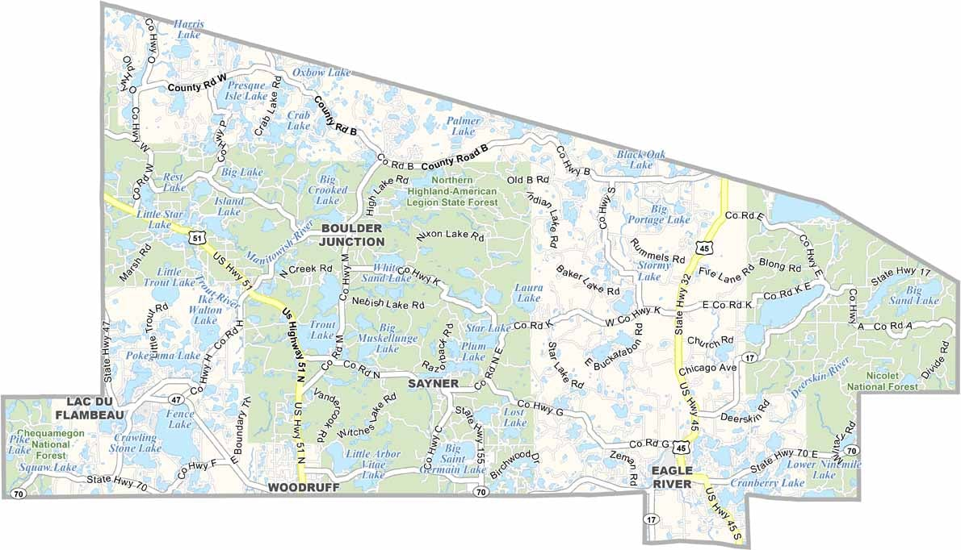

Northwoods EMS District
Four Towns in Vilas County:
Boulder Junction
Manitowish Waters
Presque Isle
Winchester

Slide 3
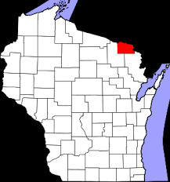
Florence County
Florence County Rescue Squad serving Towns of:
  Florence, Commonwealth, Fence & Fern
Florence County Rescue Squad (DBA Aurora-Homestead Rescue Squad) serving Towns of:
  Aurora & Homestead
Long Lake-Tipler Rescue Squad serving Towns of:
  Long Lake and Tipler (Florence County)
  Popple River and parts of Alvin (Forest County)
Long Lake FD had been providing EMS, but closed after a short time period

Slide 4
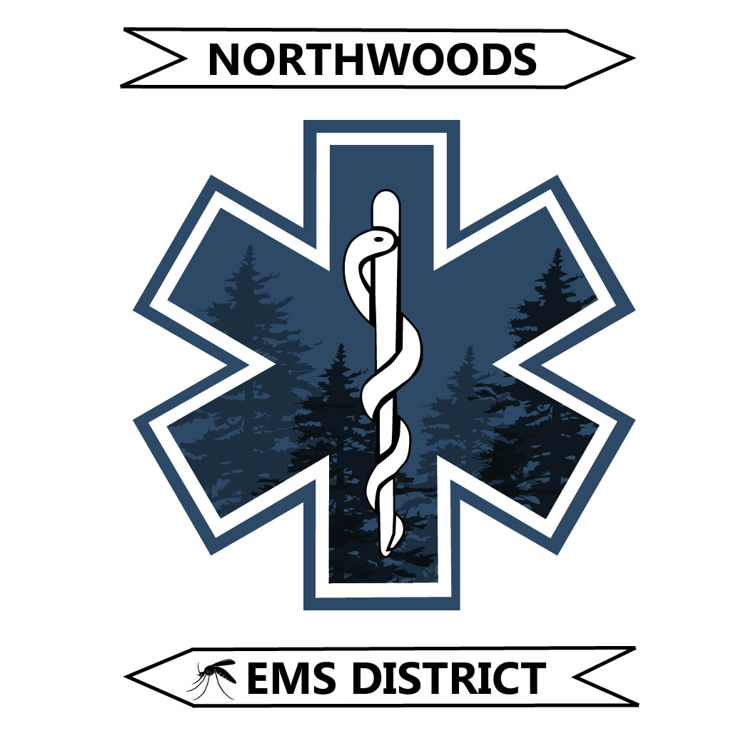
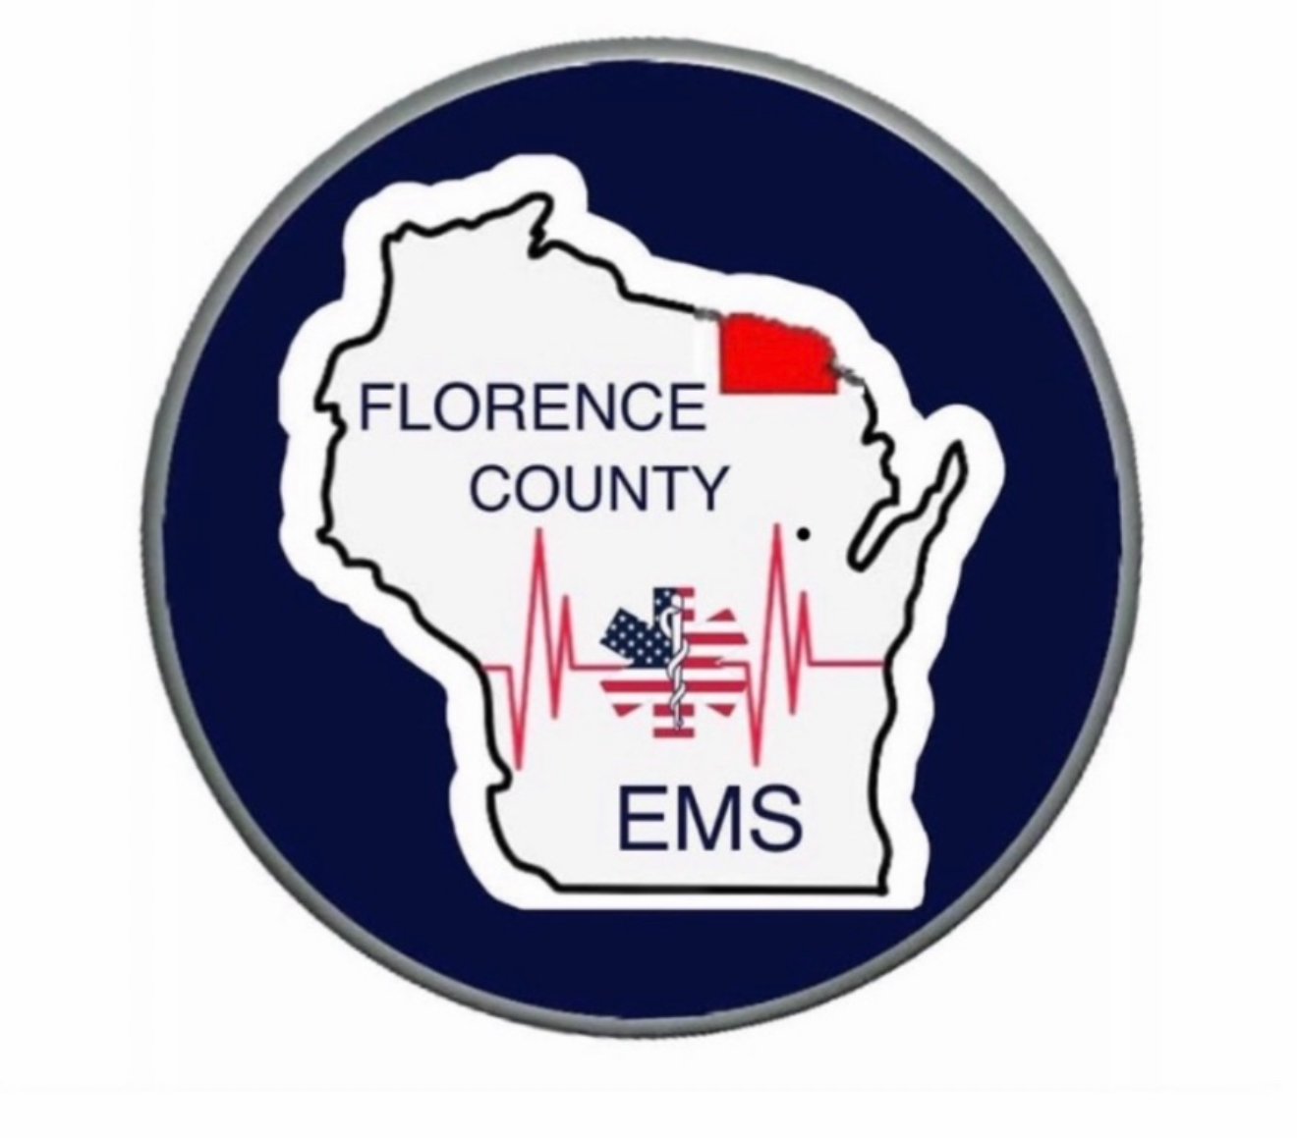
The "Why Now" Moment

Slide 5
How the First
Conversation Happened

Slide 6
The Governance Structure

Slide 7
The Cost-Sharing Formula

Slide 8
What Had to be Given Up — Was it Worth It?

Slide 9
Politics,
Elected Officials, and the Public

Slide 10
Labor and Workforce Considerations

Slide 11
The Measured Outcomes

Slide 12
Anything to do Differently?

Slide 13

Starting Point for You?

Slide 14

Outline
Dana Sechler
danasechler@hotmail.com
(608) 963-2380

