Slide 1



MUSA Feasibility Overview
A Model for Local Government Collaboration
FUNDED BY A DOR INNOVATION PLANNING GRANT
Mark Rohloff McMAHON ASSOCIATES, INC.
PUBLIC SAFETY & MUNICIPAL MANAGEMENT DIVISION MGR.
JUNE 11, 2026

Slide 2
What is a MUSA?
Stands for… MUnicipal Services Agency
Concept modeled after CESA
  Comprehensive Education Services Agency
  Provide services to school districts they would otherwise not be able to provide themselves

Slide 3
Why MUSA?
Address staffing and capacity constraints
Provide
cost-effective shared services
Allows focus on
core municipal responsibilities

Slide 4
Key Challenges
Limited funding for municipalities
Staff shortages and burnout
Rising service complexity
How to start up? What model?
Determining what Wisconsin municipalities need/want

Slide 5
What Members Want
Survey conducted by Whitburn Center at UW-Oshkosh
Over 200 responses out of 605 League members
Some key services identified:
  GRANT WRITING & ADMINISTRATION
  IT & CYBERSECURITY
  POLICY SUPPORT
  & TRAINING
  CAPITAL PLANNING

Slide 6
What Other States Do…
Alaska Municipal League
Montana League of Cities & Towns
  Provides basic financial services
  Enables clerks to focus on other functions
  As Alaska developed, other services added
  Voluntary participation
  Fee for service
  Demand has grown significantly since inception

Slide 7
Critical Insight on Services
Business Plan developed by Dr. Choton Basu, UW-Whitewater
Must be affordable
Must be available to broad clientele
Must save time or reduce risk
Flexible usage preferred over subscriptions
(i.e. hourly rates)

Slide 8
Recommended Strategy
Start with finance and accounting services
  Accounts Payable
  Bank Reconciliation
  General Ledger
  Budget/Reporting
  Audit and Financial Statement Preparation
Pilot with 10 -15 municipalities
Expand based on demand

Slide 9
Governance
Housed within League
Board oversight
Advisory group of practitioners
No separate MUSA entity needed

Slide 10
Funding Approach
Startup backstop funding required
Transition to client-funded model
5-year plan to self-sufficiency

Slide 11
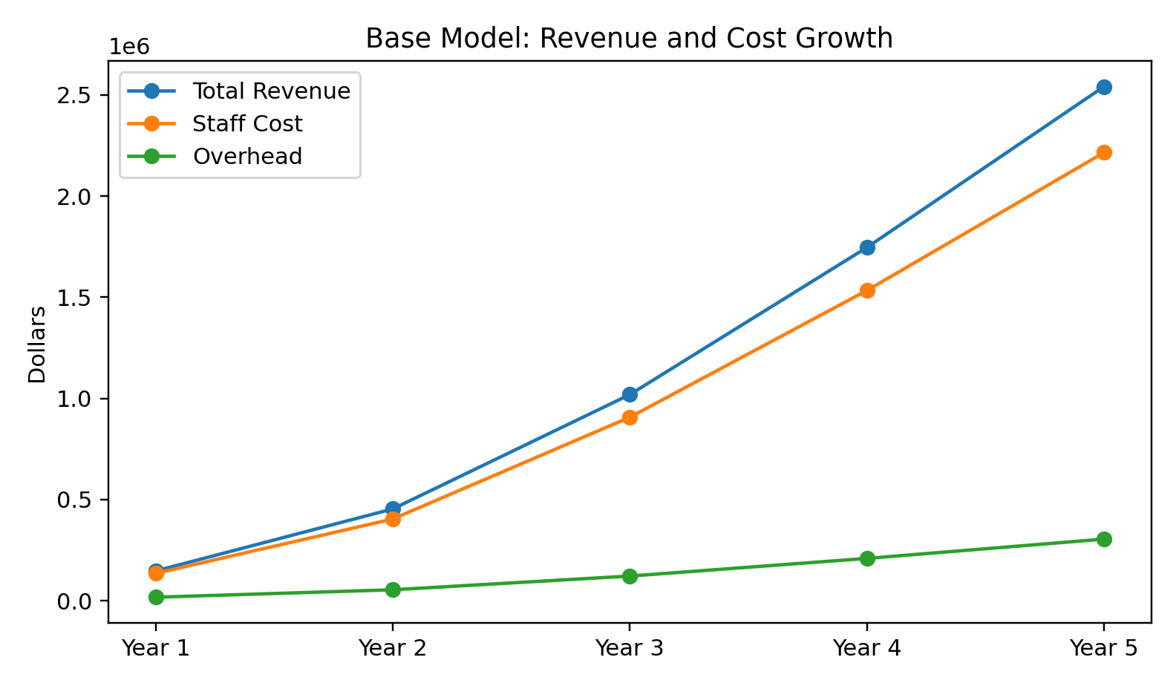
Financial Projection (Revenue vs Cost)
Year | Total Municipalities | Total Revenue | FTE Staff | Staff Cost | Overhead | Net Income
Year 1 | 12 | $147,560 | 1.08 | $135,342 | $17,707 | ($5,489)
Year 2 | 30 | $454,120 | 3.23 | $404,355 | $54,494 | ($4,729)
Year 3 | 60 | $1,019,280 | 7.24 | $907,291 | $122,314 | ($10,325)
Year 4 | 95 | $1,746,580 | 12.24 | $1,533,874 | $209,590 | $3,116
Year 5 | 130 | $2,541,760 | 17.68 | $2,215,596 | $305,011 | $21,153

Slide 12
Risks to Manage
Underpricing services
Overstaffing too early
Demand exceeding capacity
Distrust over transferring responsibilities
Startup capital

Slide 13
What This Means for
Local Government Officials
Access to expertise you cannot afford full-time
Improved financial compliance
More secure finances = Reduced risk
Reduced workload for staff = less burnout

Slide 14
Implementation Plan
Proceed with pilot program
Maintain disciplined focus/
Stabilize operations
Seek 15-30 municipalities
for pilot program
Scale after success is proven

Slide 15
Q&A
Thank you for allowing me to present today.
Mark Rohloff McMAHON ASSOCIATES, INC.
PUBLIC SAFETY & MUNICIPAL MANAGEMENT DIVISION MGR.
mrohloff@mcmgrp.com

