Slide 1
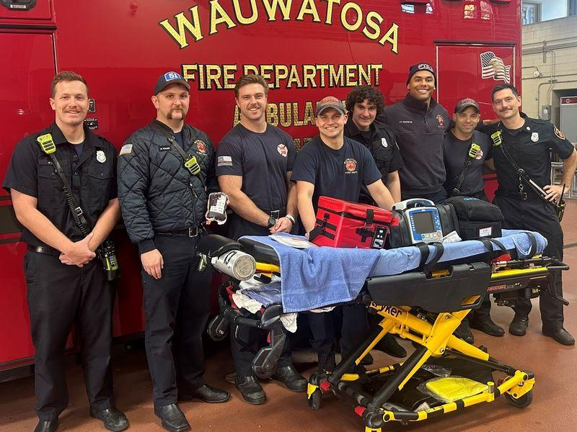

Milwaukee
Metro Fire
Rescue
Joint Presentation
West Allis & Wauwatosa

Slide 2
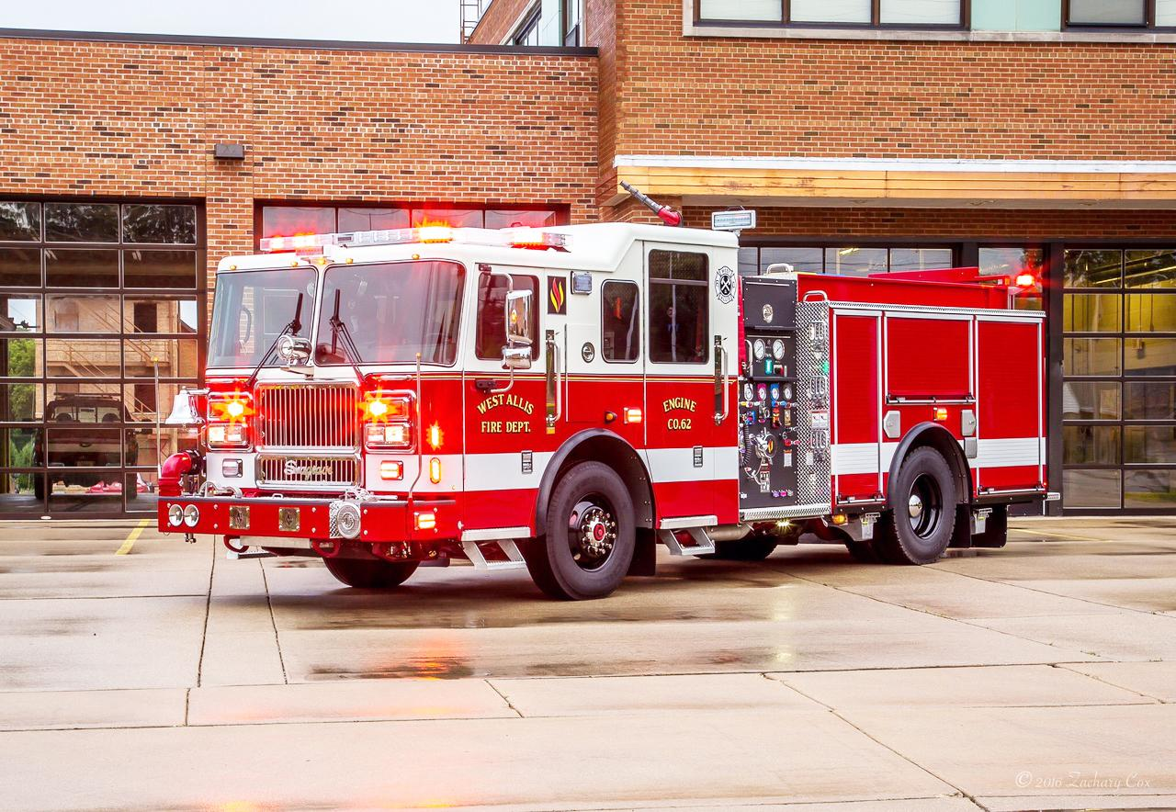
Operational Similarities
SHARED EMS PROTOCOLS
JOINT TRAINING ACADEMY
COUNTYWIDE MUTUAL AID
EXISTING OPERATIONAL COORDINATION

Slide 3
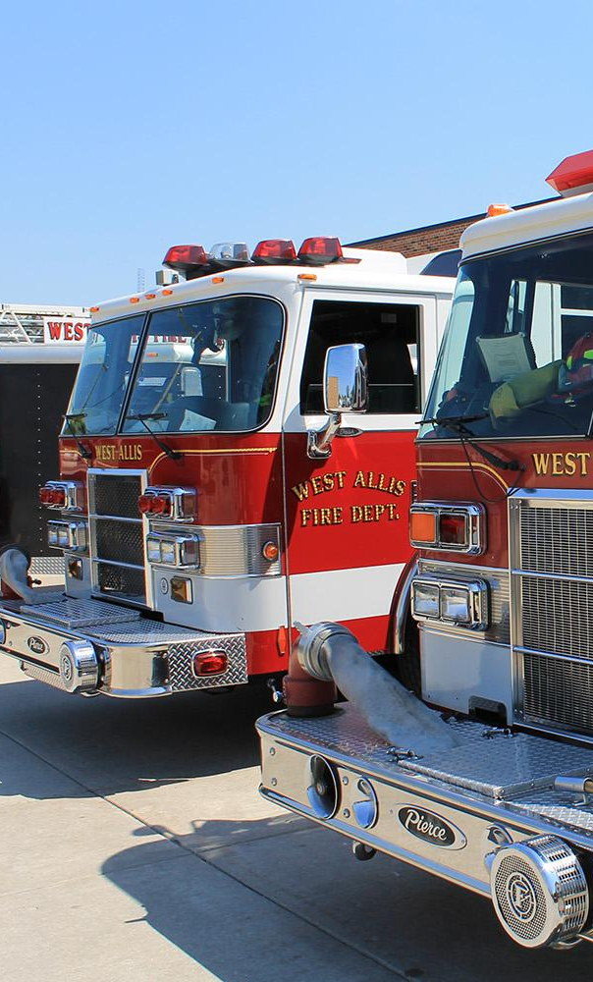
Why Now?
Financial pressures
and levy limits
  Staffing shortages and overtime
  Need to preserve service levels
  Long-term sustainability

Slide 4
Study Findings
$1.3 million projected Year 1 savings
  $7 million projected five-year savings
  No recommended reduction in front-line staffing
  Enhanced operational coordination

Slide 5
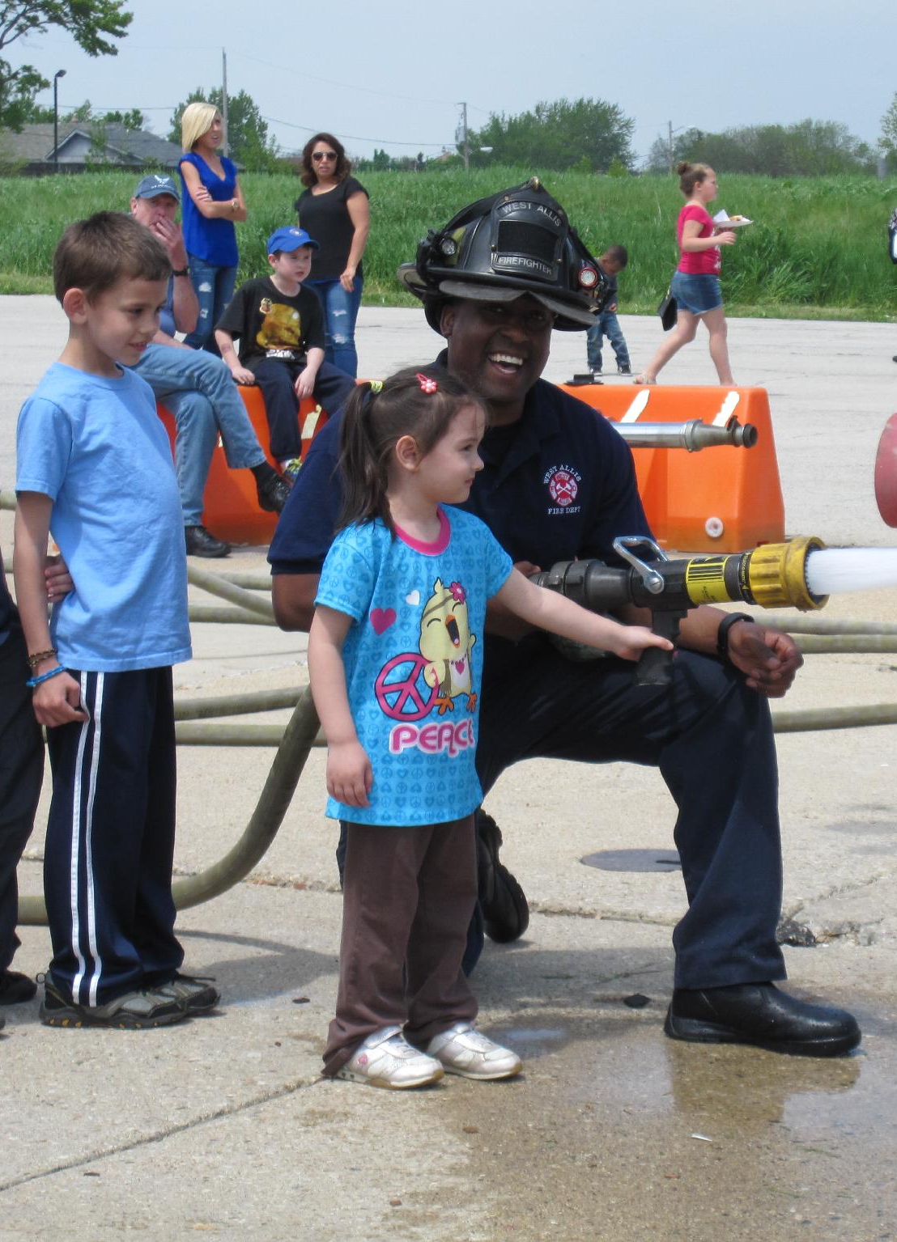
Governance
Structure
Joint nonprofit municipal corporation
  Equal representation from both cities
  Joint Fire Commission oversight
  Open meetings and public accountability

Slide 6
Operational Benefits
The study found that both departments are functionally very similar in terms of operations, staffing models, and service delivery expectations.
The report also identified several opportunities for improvement through consolidation.
These include:
  Enhanced training coordination
  Better apparatus planning
  Improved administrative efficiency
  Stronger regional coordination
  Expanded public outreach capabilities
  Improved operational sustainability

Slide 7
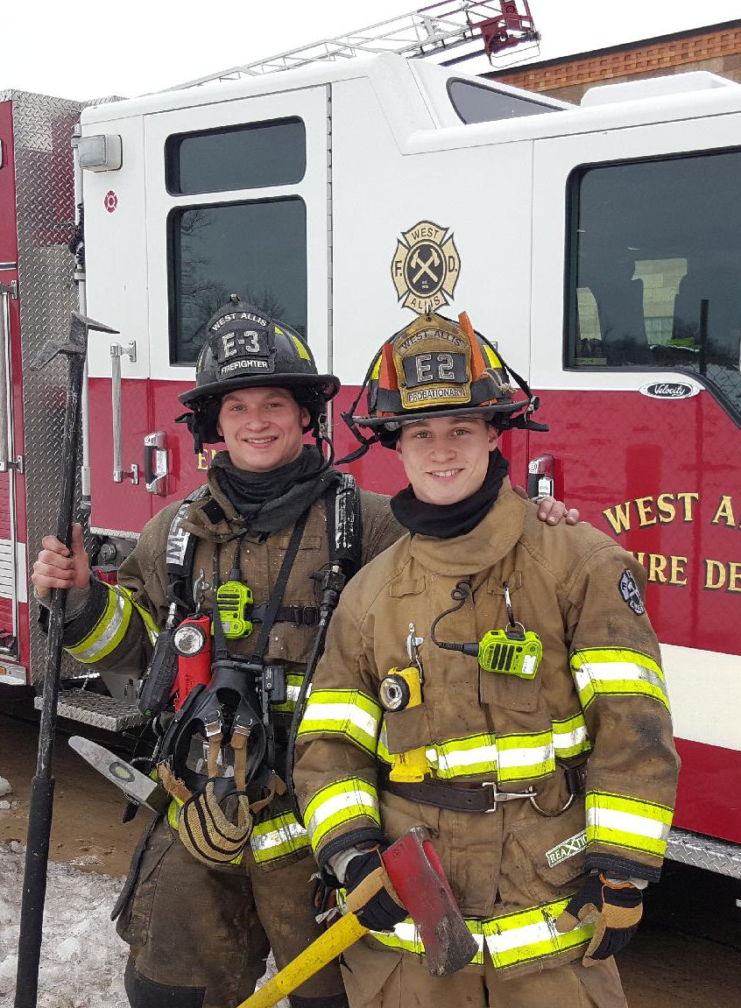
Workforce Considerations
Collective bargaining discussions
  Benefit alignment planning
  Staffing preservation focus
  Transition stability

Slide 8
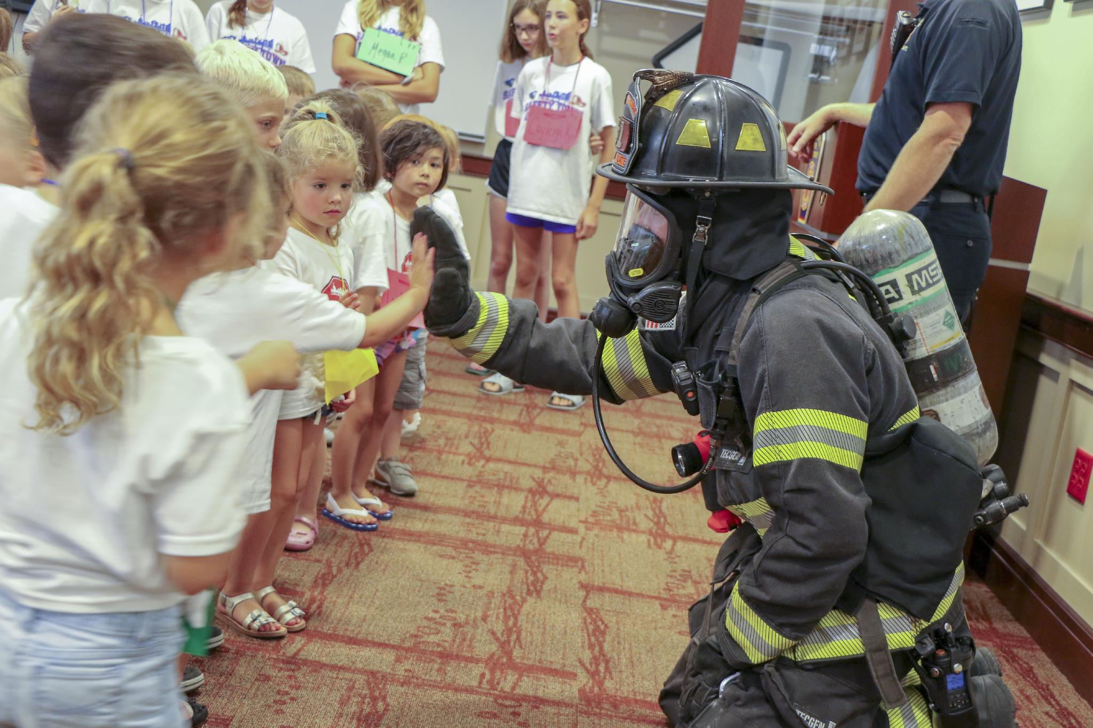
Workforce Considerations
21,800+ annual emergency incidents
100,000+ residents served
Enhanced training opportunities
Long-term fiscal sustainability

Slide 9
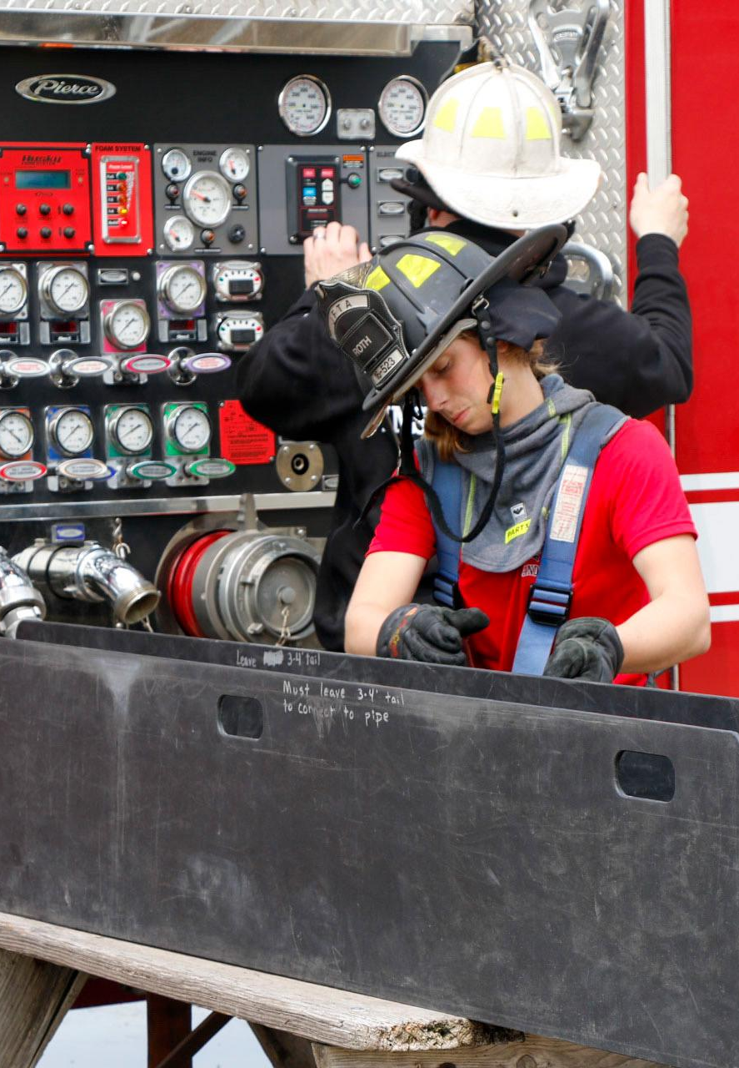
Lessons Learned
Communications matters
Leaders must constantly communicate not only what is changing, but why it is changing.
Operational integration is easier than cultural integration.
Policies can be aligned relatively quickly.
Proposal includes phased implementation, continued stakeholder involvement, and long-term governance planning.

Slide 10
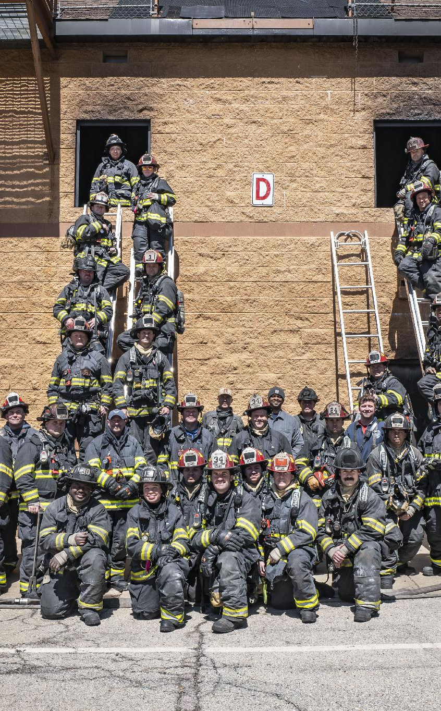
Closing Message
Collaboration is leadership
Protecting future public safety services
Regional resilience and sustainability
Building for the next generation

