Slide 1




Collaboration in Action
Village of Paddock Lake, Village of Salem Lakes, Village of Walworth Road Maintenance and Public Works Consortium

Slide 2
Agenda
Introduction
Consortium Overview
Innovation Grant
Lessons Learned

Slide 3
Introduction

Slide 4
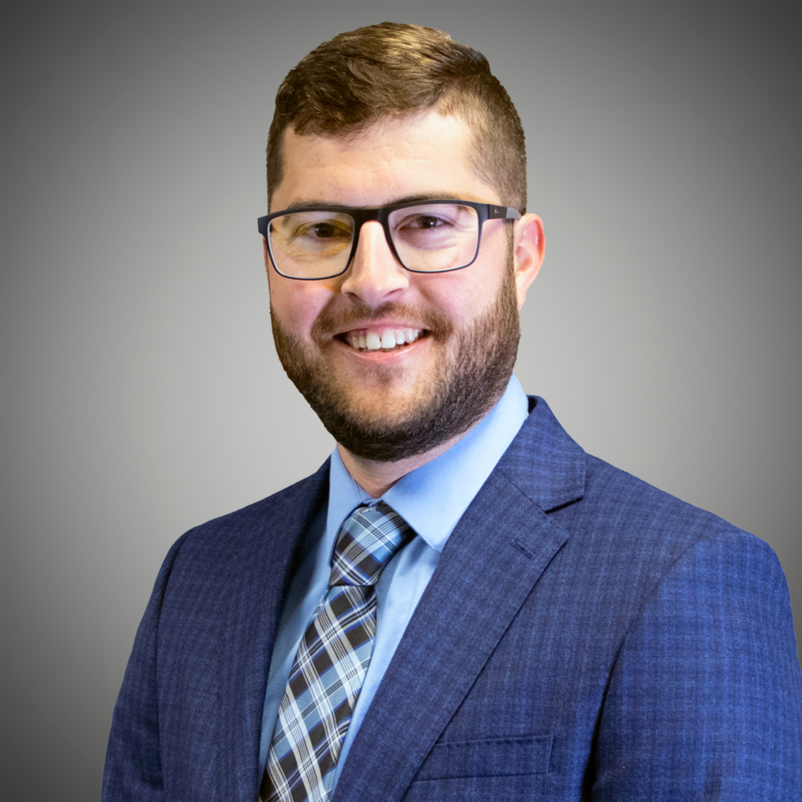
Speaker
Jason Atchison, PE
  Village of Paddock Lake Engineer
  Baxter & Woodman
  Project Manager

Slide 5
Why Now
Rising costs + limited staff capacity
Increasing infrastructure demands
Need for more efficient service delivery
Regional collaboration became necessary

Slide 6
How It Started
Conversations between neighboring communities
Shared challenges identified quickly
Informal coordination evolved into formal planning
Leadership alignment drove momentum

Slide 7
Consortium Overview

Slide 8
What is a consortium?
A consortium is a group of municipalities or agencies that collaborate to pool resources and achieve cost savings by jointly purchasing or bidding shared services and commodities.

Slide 9
Types of Services That Can Be Purchased Jointly
Crack Sealing
Resurfacing
Tree Trimming
Concrete
Sewer Lining
Leak Detection
Hydrant Painting
Sewer Televising
Contractor Assistance
Cold Patch
Hauling/Delivery
Pavement Marking
Janitorial Services
Bridge Inspections
Municipal Auditing
Street Sweeping
Tree Maintenance
Generator Maintenance
Asphalt Patching
Cross Connection Control
Inspectional Services
Rock Salt
Information Technology Services
Auditing Services

Slide 10
Benefits
Collaborative Framework
The consortium unifies multiple municipalities to reduce costs and improve service quality through collaboration.
Economies of Scale
Consolidated procurement and contract management leverage economies of scale and enhance vendor competitiveness.
Sustainability and Efficiency
Shared administration and standardized practices foster regional cooperation and long-term cost efficiency.
Notes:
Requires Collaboration between communities and Engineers, Uniform Specs and bid items

Slide 11
Key Lessons and Best Practices
Leadership & Collaboration
Strong leadership and ongoing management support are essential. Share workload and maintain transparency.
Planning & Coordination
Develop a master schedule and bid calendar; hold semi-annual manager meetings for alignment.
Efficiency & Cost Savings
Joint bidding reduces overhead costs and benefits smaller communities. Start with simpler projects and renegotiate contracts when needed.
Continuous Improvement
Share best practices, value contractor feedback, and incorporate new ideas and alternative concepts.
Technical Enhancements
Utilize roadway rating concepts and utility locating; smaller communities can reduce reliance on engineering firms for bid specs.
Relationship Building
Established partnerships lead to additional shared services and long-term opportunities.

Slide 12
Need a Champion
Why do you need a champion
Role of Champion
Make sure all participating communities bid specs are aligned
Develop project schedule
Aggregate quantities
Bid projects
Communicate results

Slide 13
Potential Concerns and their Solutions
Concern | Solution
Difference in bid specifications | Form committees and write new bid specifications or utilize established specifications
Difference in budget years | Publish bid calendar and multiple bidding groups for some services
Contractor scheduling concerns | Create geographic area groups for some services
Different sources of funding (MFT vs. non-MFT) | Create specific bid pay items within the joint bid for items that must be completed to agency standards
Staff reductions | Each municipality still manages the construction contract and work within their jurisdiction

Slide 14
Consortium Board and Organizational Structure
Consortium Board
Technical Advisory Group
Public works directors, engineers, or designated staff
Provides technical recommendations to the Consortium Board
1-2 representatives from each participating municipality

Slide 15
Timeline
12 Jan. 2026
1st introduction of concept to interested Parties
16 Feb. 2026
Introduction of draft contract/agreement to interested parties
26 Feb. 2026
Final contract/agreement distributed for signature
26 Mar. 2026
Sign off due with 2025 annual transferred services fees documentation
31 Mar. 2026
Application submitted
10 Dec. 2025
First internal Discussion of Pavement Consortium and DOR Grant

Slide 16
Innovation Grant
Innovation Grant

Slide 17
Grant Requirements
Formal Duty Transfer
Consortium must formally transfer procurement, contract management, and reporting duties to transferee (Private Entity or Lead municipality).
Agreement Duration
A minimum three-year agreement is required, with five years recommended for maximum grant payments.
Cost Documentation and Tracking
Baseline cost documentation and annual cost tracking ensure compliance with the 115% cost cap.
Grant Payment Formula
Grants provide annual payments equal to 25% of prior-year costs per municipality, up to five years.
Application Deadline
March 31, 2026

Slide 18
Potential Services to be Transferred from Each Municipality to Consortium
Road construction and paving
Road maintenance and repair
Culvert, ditching, and drainage work
Public works project management
Procurement and bidding
Contractor oversight
Inspection and quality control

Slide 19
Payout structure
Grants provide annual payments equal to 25% of prior-year costs per municipality, up to five years
Fund distribution timeline
2026-2030 (25% each year)
Distribution is outlined in application with funds primarily distributed to “Transferors”

Slide 20
Potential Uses of Grant Funds
Offset Administrative Costs
Program Manager
Pavement Management Report
Establishes 5 year goals outlining priority projects within each Municipality
Purchase of Maintenance Equipment
Training
Consultant led bidding process and contract administration

Slide 21
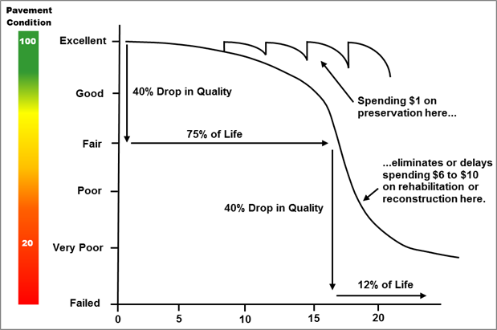
Shared Roadway Maintenance Program
Shared Roadway Maintenance Program
Pavement Management Reports
Accurate Pavement Assessment
  Vehicle-mounted 3D LiDAR technology captures precise pavement data and municipal assets, ensuring ASTM-compliant evaluations.
AI-Driven Analysis:
  Machine learning identifies pavement distresses and delivers consistent, objective ratings for efficient rehabilitation planning.
Key Benefits
  Faster data collection (up to 50 miles/day), improved accuracy, and easy digital integration with GIS for long-term planning.
Pavement Management Reports
Accurate Pavement Assessment
  Vehicle-mounted 3D LiDAR technology captures precise pavement data and municipal assets, ensuring ASTM-compliant evaluations.
AI-Driven Analysis:
  Machine learning identifies pavement distresses and delivers consistent, objective ratings for efficient rehabilitation planning.
Key Benefits
  Faster data collection (up to 50 miles/day), improved accuracy, and easy digital integration with GIS for long-term planning.

Slide 22
Lessons Learned

Slide 23
Tips for Success
Start small & Start early
Strong leadership matters
Standardization is key
Communication drives success

Slide 24
How to get started?
Start with one shared service
Build from existing relationships
Focus on practical wins
Scale over time

Slide 25
Questions?
Jason Atchison, PE
Baxter & Woodman, Inc.
jatchison@baxterwoodman.com
815-444-3279

Slide 26
How Do You Start?
Reach out to nearby communities
Identify common opportunities
Form discipline-specific committees
Confirm champion community for each project
Compare bid specifications
Find best practices

